Slide 1

Lecture 6 – 1
EE 272 Digital Systems Fall 2019
Instructor: Dr. Aashir Waleed
Chapter 5

Slide 2
Overview
Lecture 6 – 2
 Sequential Logic
 Latches
 D-type latch
 RS latch
 Synchronous Systems, Clock
 Flip-Flops
 D-type Flip Flop
 Other Flip-flops (JK,T)
 Latch/Flip-flop Implementations
 Asynchronous and Synchronous Inputs
 Timing: Setup, hold, propagation delay

Slide 3
Sequential Logic
Lecture 6 – 3
 Sequential Logic is the combinational Logic with a FEEDBACK path
 Feedback path connect output back to input
 Output in combinational logic depends ONLY on the combination of CURRENT input bits
 Output in sequential logic depends on the combination of CURRENT input bits AND the sequence of PAST input bits (history!)
 So sequential logic REMEMBERS sequence of past input bits and hence has a MEMORY!

Slide 4
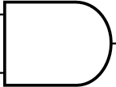
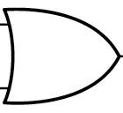
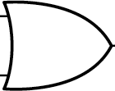
NAND/NOR Conversion
Lecture 6 – 8
R’
S
S
Q
R’
Q
X’
Y’
R
S’
S
Q
R’
Q
X’
Y’
R’ | S | X | Q | State
0 | 0 | 0 | 0 | Reset
0 | 1 | 1 | 0 | Reset
1 | 0 | Q | Q | Memory
1 | 1 | 1 | 1 | Set
S | R’ | Y | Q | State
0 | 0 | 0 | 0 | Reset
0 | 1 | Q | Q | Memory
1 | 0 | 0 | 1 | Set
1 | 1 | 1 | 1 | Set

Slide 5
NAND/NOR Conversion
Lecture 6 – 9
R
S’
S
Q
R’
Q
X’
Y’
X’ = Q’
Y’ = Q’
R’ | S | X | Q | State
0 | 0 | 0 | 0 | Reset
0 | 1 | 1 | 0 | Reset
1 | 0 | Q | Q | Memory
1 | 1 | 1 | 1 | Set
S | R’ | Y | Q | State
0 | 0 | 0 | 0 | Reset
0 | 1 | Q | Q | Memory
1 | 0 | 0 | 1 | Set
1 | 1 | 1 | 1 | Set
R | S | X’ | Q | State
0 | 0 | Q’ | Q | Memory
0 | 1 | 0 | 1 | Set
1 | 0 | 1 | 0 | Reset
1 | 1 | 0 | 0 | Forbidden
S’ | R’ | Y’ | Q | State
0 | 0 | 1 | 1 | Forbidden
0 | 1 | 0 | 1 | Set
1 | 0 | 1 | 0 | Reset
1 | 1 | Q’ | Q | Memory

Slide 6



NOR Conversion – SR Latch
Lecture 6 – 10
R=0
S=0; R=0; Memory → Keeping the bit Q
S=0
Q Q’
Q
Q’
0
A
S=1; R=0; SET → LOAD ‘1’ into MEMORY
A’
A
A’
R=0
1
A
S=1
Q =1
Q’=0
0
R | S | Q’ | Q | State
0 | 0 | Q’ | Q | Memory
0 | 1 | 0 | 1 | Set
1 | 0 | 1 | 0 | Reset
1 | 1 | 0 | 0 | Forbidden
S=0; R=1; RESET → LOAD ‘0’ into MEMORY
R=1
S=0
Q=0
Q’=1

Slide 7
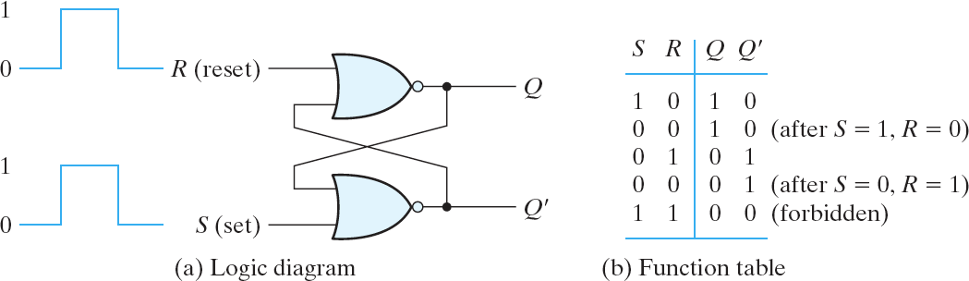
SR Latch: Cross-coupled NOR gate
Lecture 6 – 11
R
R | S | Q’ | Q | State
0 | 0 | Q’ | Q | Memory
0 | 1 | 0 | 1 | Set
1 | 0 | 1 | 0 | Reset
1 | 1 | 0 | 0 | Forbidden
S
Q
Q’

Slide 8
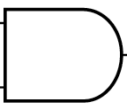
NAND Conversion – S’R’ Latch
Lecture 6 – 12
S’=1; R’=1; Memory → Keeping the bit Q
R’=1
S’=1
Q
Q’
Q
Q’
1
A
S’=0; R’=1; SET → LOAD ‘1’ into MEMORY
A’
A
A’
S’=0
R’=1
Q=1
0
A
Q’=0
1
S’ | R’ | Q’ | Q | State
0 | 0 | 1 | 1 | Forbidden
0 | 1 | 0 | 1 | Set
1 | 0 | 1 | 0 | Reset
1 | 1 | Q’ | Q | Memory
S’=1; R’=0; RESET → LOAD ‘0’ into MEMORY
R’=0
S’=1
Q=0
Q’=1

Slide 9
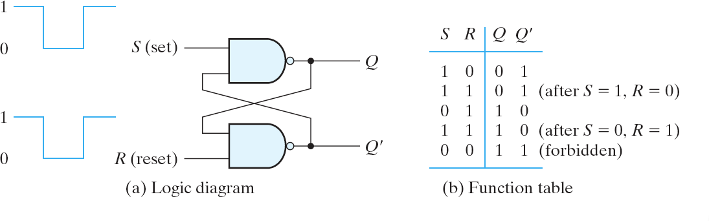
S’R’ Latch: Cross-coupled NAND gate
Lecture 6 – 13
S’
R’
Q
S’ | R’ | Q’ | Q | State
0 | 0 | 1 | 1 | Forbidden
0 | 1 | 0 | 1 | Set
1 | 0 | 1 | 0 | Reset
1 | 1 | Q’ | Q | Memory
Q’
It doesn’t matter what you call the inputs (S’ vs S or R’ vs R), the function is the same!

Slide 10
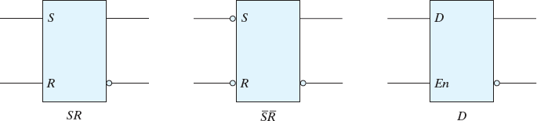
Latch (SR, S’R’, and D-type)
Lecture 6 – 14
A latch is a storage elements that operate with signal levels (not signal transition)
To set Q=1; S=1 and R=0 To reset Q=0; S=0 and R=1 Avoid both inputs ‘1’
Q
To set Q=1; S=0 and R=1 To reset Q=0; S=1 and R=0 Avoid both inputs ‘0’
Q
Q
Q’
Q’
Q’
example waveforms:
En D Q

Slide 11
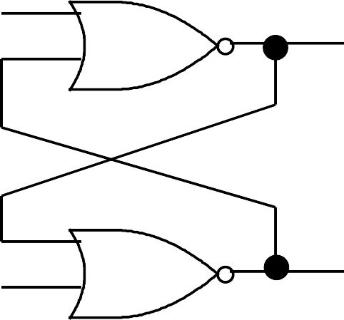
Lecture 6 – 15
A’
What happens when S,R return to 0? ^{A}
0
A
Q
0
R=1 → 0
1
0 → 1 → 0→ 1 → 0 → 1
???
0 → 1 → 0→ 1 → 0 → 1
Q’
S=1 → 0
Undefined next state when S,R return to 0 simultaneously! At some point the system will settle into a stable condition. The bottom line is that S=R=1 is an illegal input condition
NB.The SR latch can be designed such that one input is dominant,
i.e. “gates” (disables) the other, e.g.: S = S* and (not R)

Slide 12


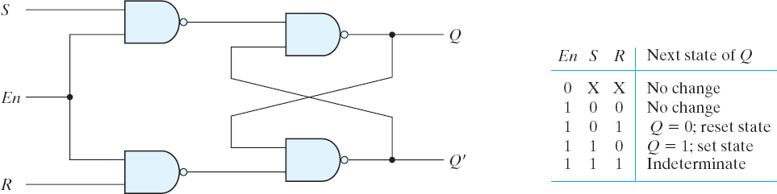
1
A
Lecture 6 – 16
Gated SR Latch
A’
A
A’
 Adds an input enable En to the basic SR latch
 En = 1, S and R are inverted and passed to the basic NAND S’R’ latch
 R=S=0, Memory
 R=1, S=0 Reset, Q=0
 R=0, S=1 Set, Q=1
 R=S=1 Forbidden, Q=Q’=1 ?
 En = 0, Memory
 The input ‘enable’ performs a clocking function.
S’
S’ | R’ | Q’ | Q | State
0 | 0 | 1 | 1 | Forbidden
0 | 1 | 0 | 1 | Set
1 | 0 | 1 | 0 | Reset
1 | 1 | Q’ | Q | Memory
R’

Slide 13
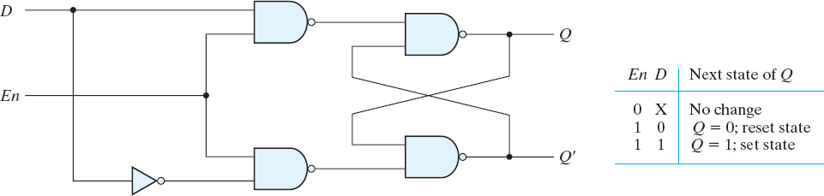
This can be used to build a D Latch
Lecture 6 – 17
 Eliminate the undesirable condition for both S=R=1
 Use only two useful functions, set and reset (S=0,R=1 or R=0,S=1)
 Require only one input, D for data

Slide 14
D Latch – different implementations…
Lecture 6 – 18
 Using logic gates (4.5 equivalent gates)

Slide 15
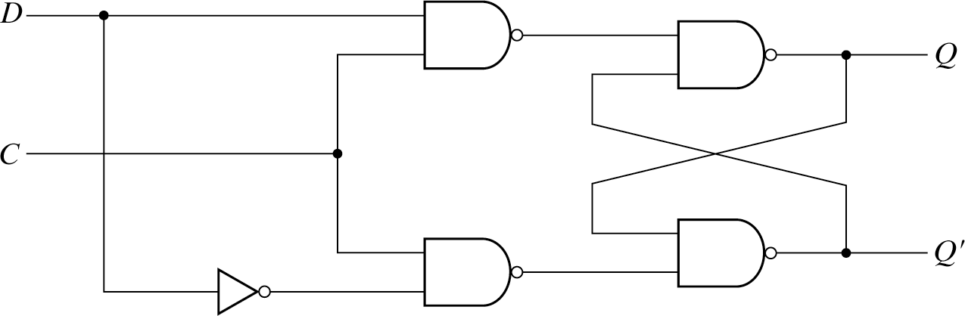
Lecture 6 – 19
 D-latch implemented using NAND gates
– 4.5 equivalent gates

Slide 16
Timing Waveform to show D-Latch Operation
Lecture 6 – 21
D
C=Enable Q
C is low, D has no effect on Q
C is low, Q retains D value when C went 1→ 0
C is high, Q follows D (transparent mode)

Slide 17
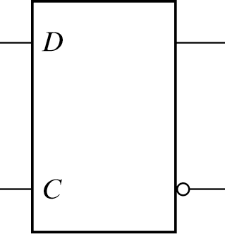
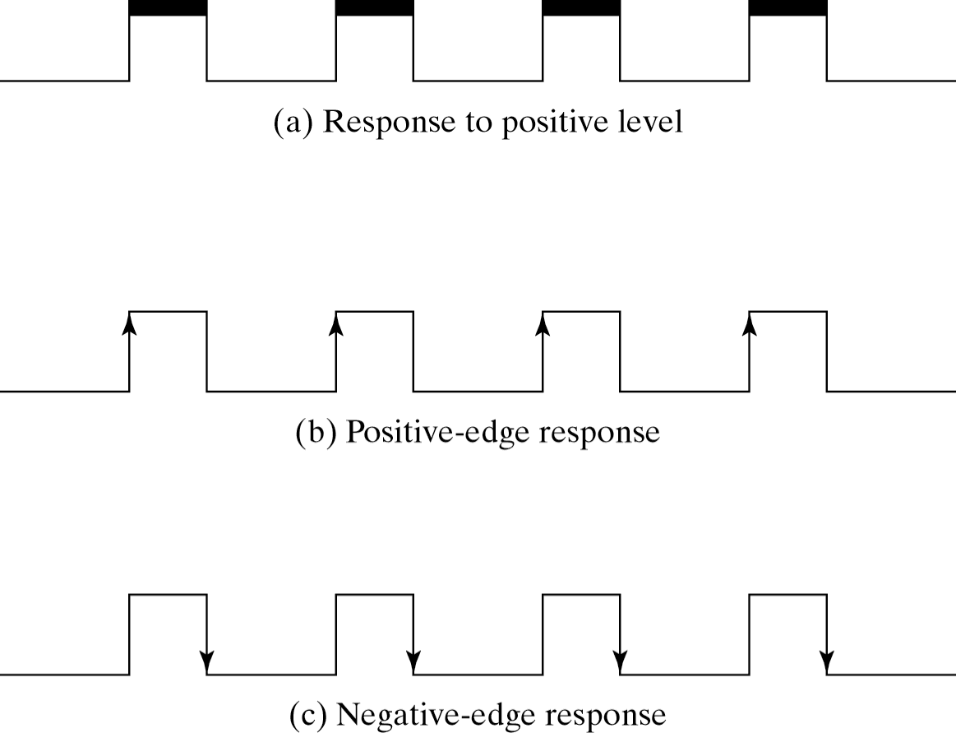
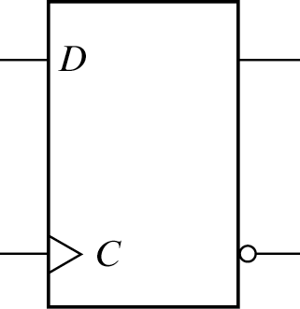
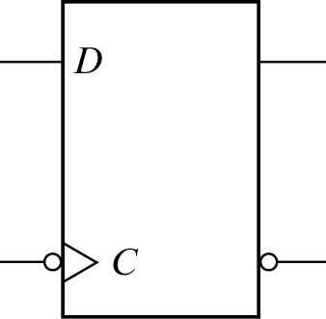
Latches and Flip-flop
Lecture 6 – 22
 A latch is a storage elements that response to a change in the level of a clock (Enable) pulse
 Flip-flop is a storage elements that are triggered by a
clock transition.
A D-latch
enable
A positive-edge triggered D-flipflop
clock
A negative-edge triggered D-flipflop
clock

Slide 18
A Clock Waveform
Lecture 6 – 23
voltage
time
τ
P_{w}
rising edge
falling edge
τ - period (in seconds)
f- frequency (in Hertz) f = 1/τ P_{w} - pulse width (in seconds)
duty cycle - ratio of pulse width to period (in %)
duty cycle = Pw /τ
Period:
Frequency:
Rising edge is also called positive edge and
Falling edge is also called negative edge
millisecond (ms) ₁₀-3 | Kilohertz (KHz) 10³
microsecond (^{μ}s) ₁₀-6 | Megahertz (MHz) 10⁶
nanosecond (ns) ₁₀-9 | Gigahertz (GHz) 10⁹
Slide by Prof Mitch Thorton

Slide 19
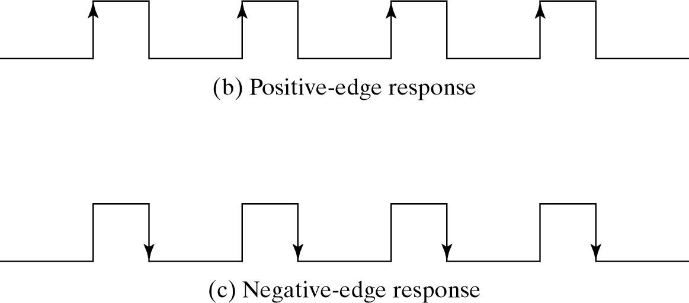
Flip-Flop: Present State & Next State
Lecture 6 – 24
 State: Output value of a flip-flop → Q
 Present State (Ps): Output value of a flip-flop at the present (current) clock cycle → Q(t) or simply Q
 Next State (Ns): Output value of a flip-flop at the next clock cycle → Q(t + 1) or simply Q⁺
A positive-edge triggered D-flipflop
A negative-edge triggered D-flipflop

Slide 20


D-type Flip-Flop (DFF, falling edge triggered)
Lecture 6 – 25
Ps : Present state (FF output value at the current clock cycle) Ns : Next State (FF output value at the next clock cycle)
Only time DFF changes state (output) is on a CLOCK EDGE.
This DFF is falling edge (bubble!) triggered. Changes state to whatever the D value is.
C | D | Ps | Ns
0 | X | Q | Q
1 | X | Q | Q
1→0 | D | X | D
D Q
C is the clock input. D input is only sampled at a clock falling (bubble!) edge
C Q’

Slide 21
D-type FF: Present State & Next State
Lecture 6 – 26
 State: Output value of a flip-flop → Q
 Present State (Ps): Output value of a flip-flop at the present clock cycle → Q(t) or simply Q (the bit value stored in FF)
 Next State (Ns): Output value of a flip-flop at the next clock cycle → Q(t + 1) or simply Q⁺ (the bit value to be stored in FF)
Q⁺ = D ^{Ns}
Ps
Q

Slide 22
DFF Operation
Lecture 6 – 27
D
C=Clock
Q
On falling edge of C, D=0, so Q=0
On falling edge of C, D=1, so Q=1

Slide 23


DFF (falling edge) built out of two D-type latches
Lecture 6 – 28
Master/Slave arrangement of two D-type latches
D _{D}
Ds
Q
Q
D Q
G Q’
G Q’
Cs
C
D Q
Master D latch
Slave D latch
C Q’

Slide 24
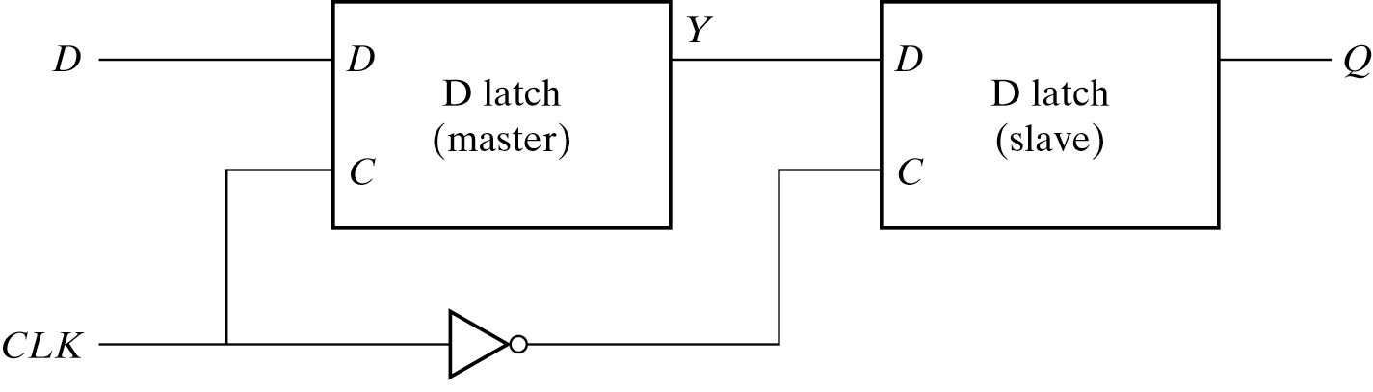
bas
D
Ds Cs
Lecture 6 – 29
Q
C
D: master
C: Enable for master
Master sampling
Master sampling
Master output Ds: D for slave
Cs: Enable for slave
Xfer to slave
Xfer to slave
Q: output of slave

Slide 25
DFF Master/Slave Implementation (rising edge triggered)
Lecture 6 – 30
D _{D}
Q
D Q
G Q’
Q
G Q’
C
D Q
Master D latch
Slave D latch
C Q’

Slide 26
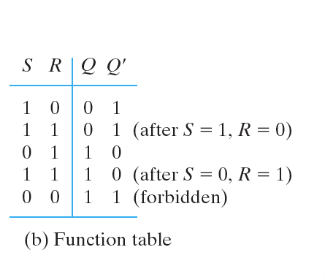
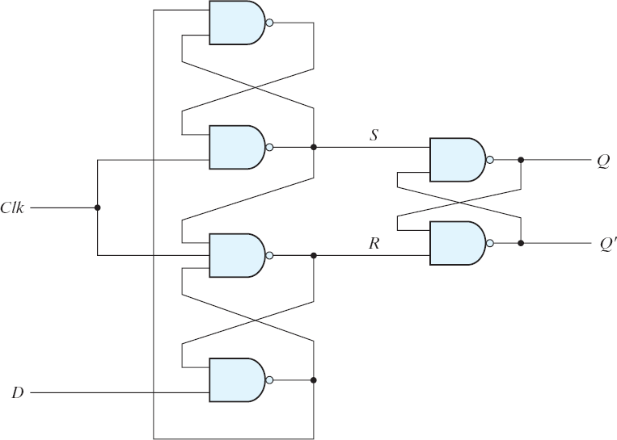
D Flip-flop Implementation with S’R’ latches
Lecture 6 – 32
When CLK = 0, Change in D does NOT change Q When CLK = 1, Change in D does NOT change Q
D’ ¹
No Change →
D D
No Change →
1 D’ D’ 1
No Change
if D = 0
if D = 1
0 1 0
No Change
1 D D 1
D D’
D’ D’ 1

Slide 27


Other Flip flop JK Flip-Flop (rising edge triggered)
Lecture 6 – 33
2 data inputs (J,K) instead of one (D) in D-flip-flop.
Implement three functions: S (set), R (Reset) and Toggle (0→1 or 1→0)
C J K Ps Ns
X X Q Q
X X Q Q
0→1 0 0 Q Q
0→1 0 1 X 0
0→1 1 0 X 1
0→1 1 1 Q Q’
JK=00 Retain State
JK=01 Synchronous Reset JK=10 Synchronous Set JK=11 Synchronous Toggle
Toggle means complement the previous output
C is the clock input.
J,K inputs are only sampled at a clock edge.
JK flip-flops were popular for TTL-based designs
J
Q
C
K
Q’

Slide 28
Timing Waveform for JKFF Operation
Lecture 6 – 34
J
K C
Q
J=1, K=0
Set
J=0, K=1
Reset
J=1, K=1
Toggle
J=1, K=1
Toggle

Slide 29

Another Flip-flop: Toggle Flip-Flop (rising edge triggered)
Lecture 6 – 35
Toggle Flip-flop (T-flip-flop) is a complementing flip-flop.
It has 1 data input (T). When T=0, a clock edge does not change the output. When T=1, a clock edge will toggle the output.
C T Ps Ns
T=0 Retain State
X Q Q
X Q Q
0→1 0 Q Q
0→1 1 Q Q’
T=1 Synchronous Toggle
TFF
T Q
C is the clock input.
T input only sampled at a clock edge.
C Q’

Slide 30
Timing waveform of TFF Operation
Lecture 6 – 36
T
C
Q
T=1 Toggle
T=0, Retain State
T=1
Toggle
T=1
Toggle

Slide 31
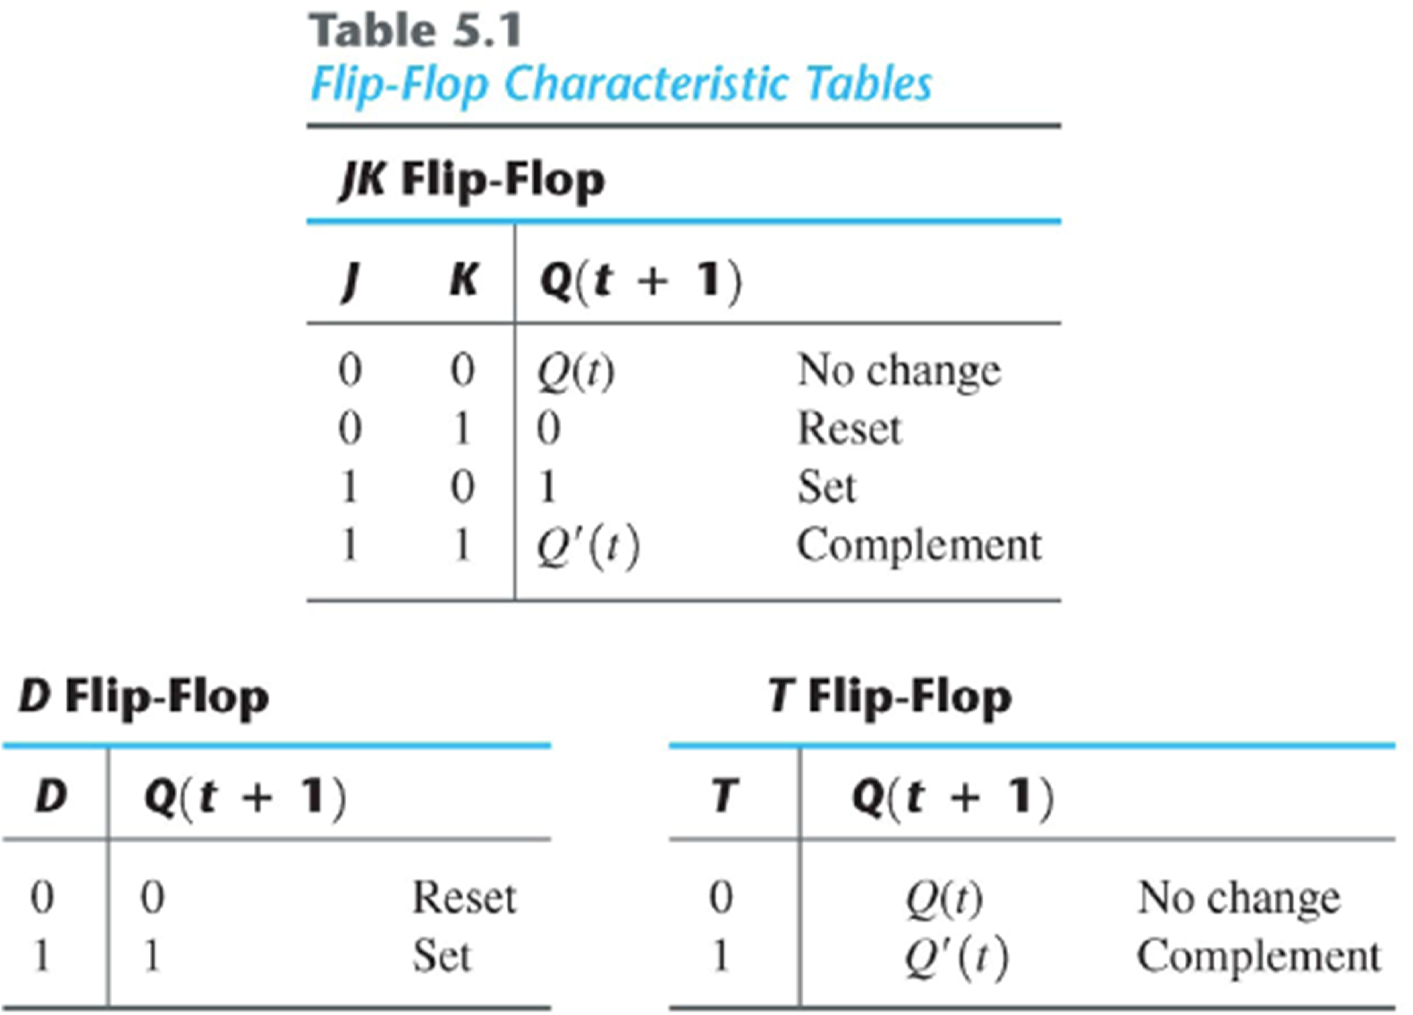
Flip-Flops (FFs) Characteristic Tables
Lecture 6 – 37

Slide 32
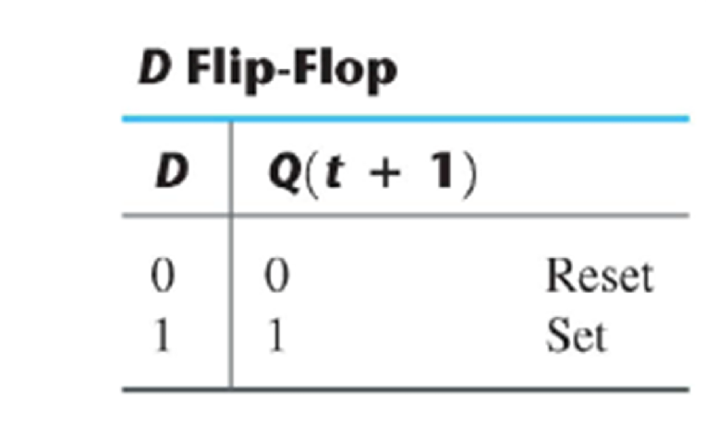
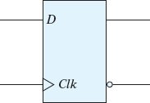
D-FF Equation
Lecture 6 – 38
D | Q | _{Q}+ | State
0 | 0 | 0 | Reset
0 | 1 | 0 | Reset
1 | 0 | 1 | Set
1 | 1 | 1 | Set
= Q⁺
K-map for Q+
D
Q
Q
D
D
For D flip-flop Q+ is independent of Q
0
1
Q⁺ depends only on D input
Q
0
1
_{Q}+
Thus Q⁺ = D
Q

Slide 33

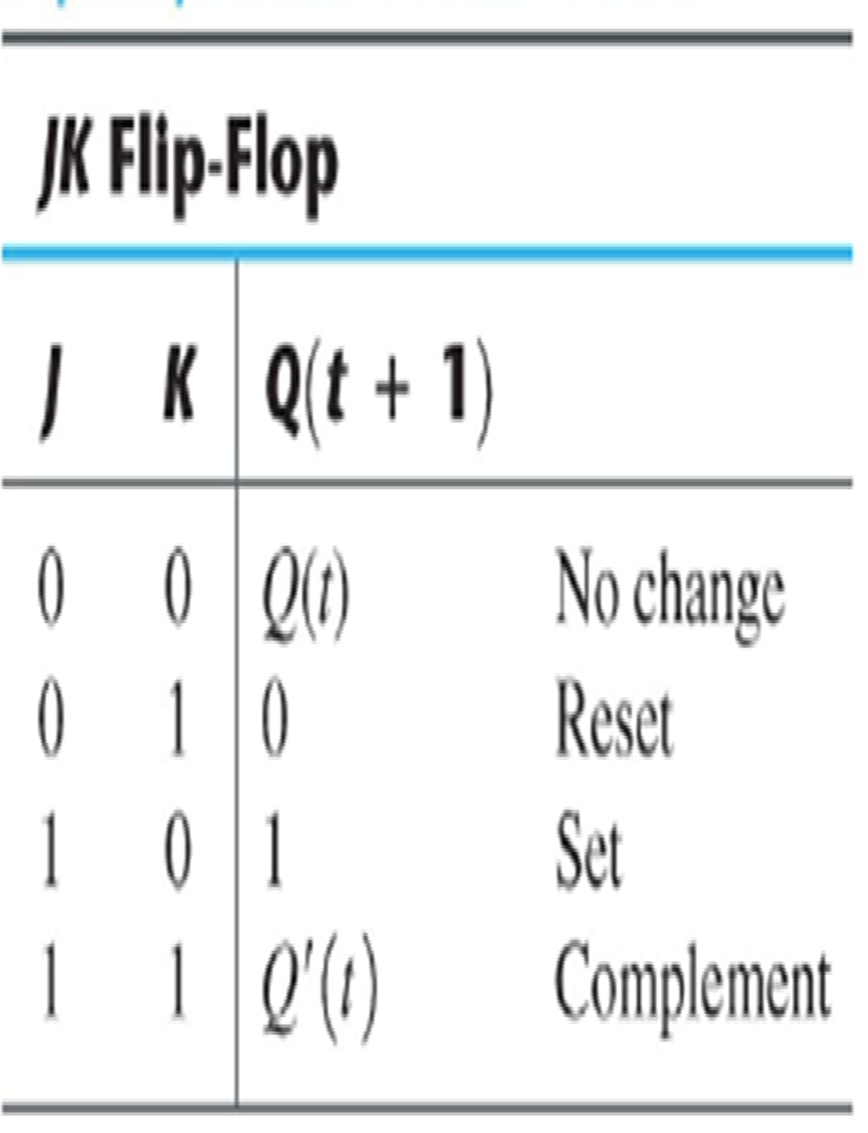
JK-FF Equation
Lecture 6 – 39
J | K | Q | Q+ | State
0 | 0 | 0 | 0 | No change
0 | 0 | 1 | 1 | No change
0 | 1 | 0 | 0 | Reset
0 | 1 | 1 | 0 | Reset
1 | 0 | 0 | 1 | Set
1 | 0 | 1 | 1 | Set
1 | 1 | 0 | 1 | Toggle
1 | 1 | 1 | 0 | Toggle
= Q⁺
Toggle = Complement
J
J
Q
J K
Q⁺ = JQ’ + K’Q
Q
00 01 11 10
0 0 0 1 1
1 1 0 0 1
C
K
Q’
K

Slide 34
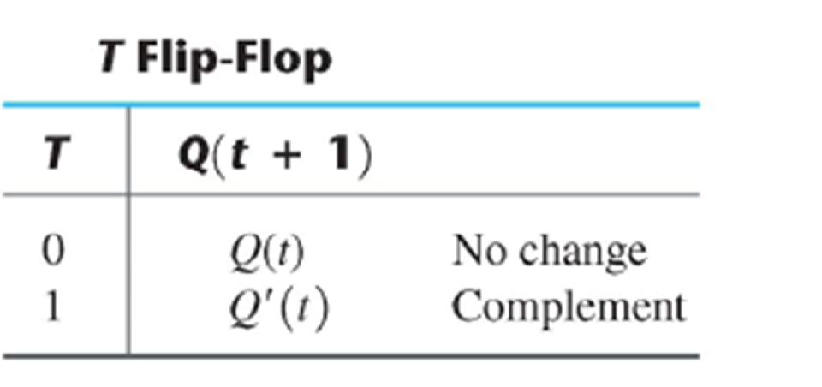

T-FF Equation
Lecture 6 – 40
T | Q | _{Q}+ | State
0 | 0 | 0 | No change
0 | 1 | 1 | No change
1 | 0 | 1 | Toggle
1 | 1 | 0 | Toggle
= Q⁺
TFF
T Q
Q
Q
T
T
T
0
1
Q⁺ = TQ’ + T’Q
Q
1
0
C Q’

Slide 35
D-type Flip-Flops (DFFs) are most common
Lecture 6 – 41
 Most programmable logic families only have DFFs
 DFF is fastest, simplest (fewest transistors) of FFs
 Other FF types (T, JK) can be built from DFFs

Slide 36

JKFF Implementation
Lecture 6 – 42
Use edge-triggered D flip-flop as the basic building block
Convert J and K inputs for the D flip-flop
– D = JQ’ + K’Q
» J=1, K=0
» J=0, K=1
» J=0, K=0
» J=1, K=1
D=1 set
D=0 reset
D=Q hold
D=Q’ toggle
K
J
Q
D Q
C
C Q’
Just substitute a falling
This is a rising edge triggered JK FF.
edge triggered DFF to make a falling edge triggered JKFF.

Slide 37
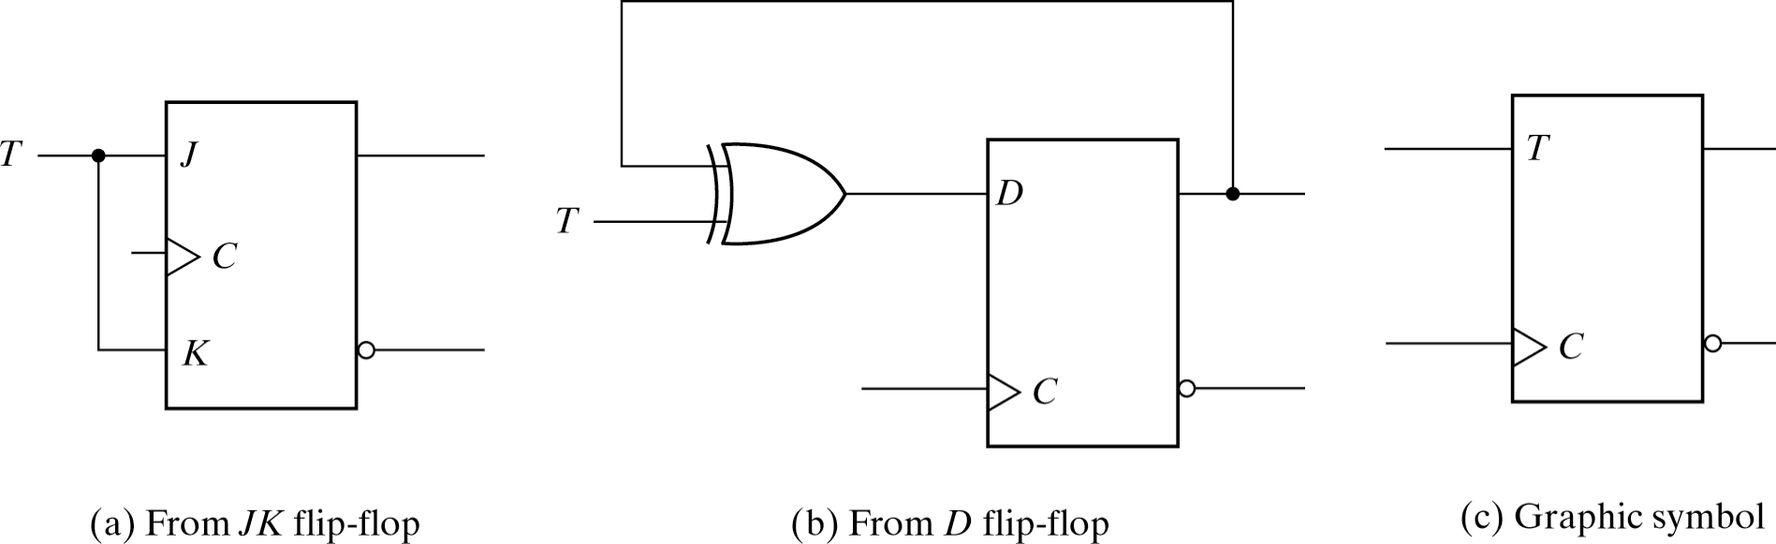
TFF Implementation
Lecture 6 – 43
Constructed from JK flip-flop
– simply tie J and K together, J=K=T
Constructed from D flip-flop
crossed output feedback
D = TQ’ + T’Q
» T=0,
» T=1,
J=K=0 J=K=1
hold toggle
» T=0,
» T=1,
D=Q hold D=Q’ toggle

Slide 38

Synchronous vs Asynchronous Inputs
Lecture 6 – 44
Synchronous input: Output will change with clock edge Asychronous input: Output changes independent of clock
Flip-Flops often have additional asynchronous
set and reset inputs.
D input of DFF is synchronous with respect to Clk
S, R are asynchronous. Q output affected by S, R independent of Clk. Async inputs are dominant over Clk. S,R inputs often called Pre (preset) and Clr (clear) inputs.
S
D
Q
Clk R

Slide 39
DFF with async control, (Pre and Clr active low)
Lecture 6 – 45
Clk
D input
?
Q (FF)
Clr
Pre

Slide 40
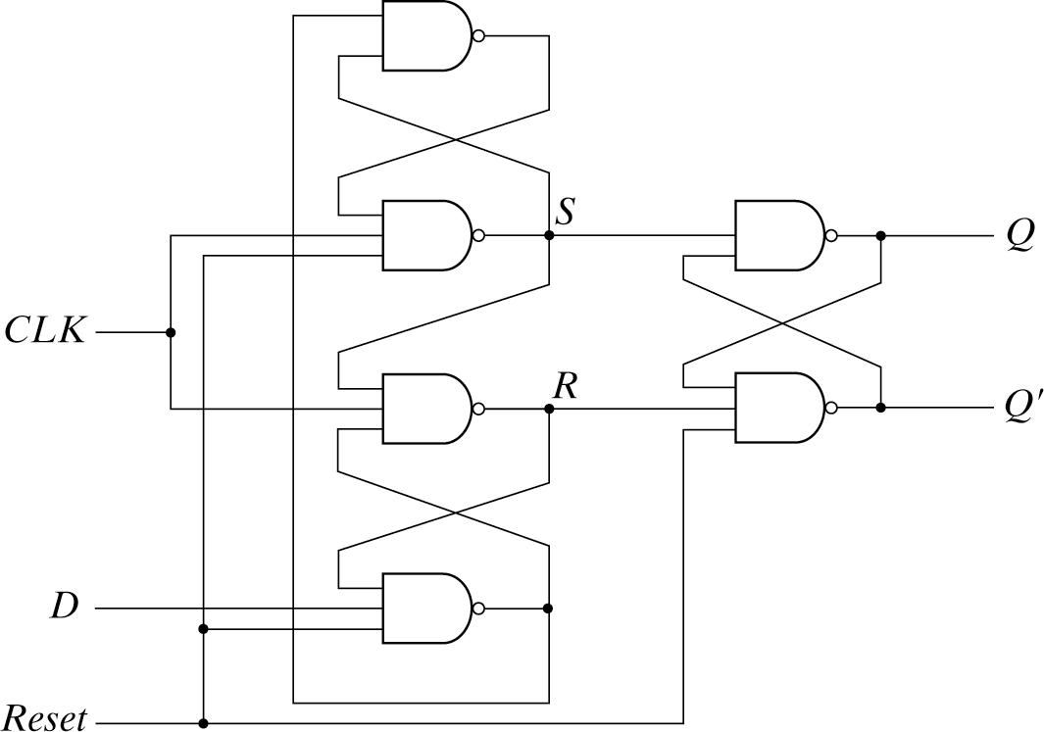
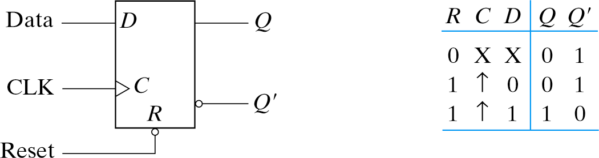
Alternative Implementation
Lecture 6 – 48
With asynchronous reset
Without asynchronous reset
1
0
1
1
0

Slide 41
Summary
Lecture 6 – 61
 Combinational vs Sequential Logic
 Synchronous vs Asynchronous Circuits
 Latches & Flip-Flops




D-type latch RS latch
D-type Flip Flop Other Flip-flops (JK,T)
 Latch/Flip-flop Implementations
 Cross-coupled gates for RS latch
 D-type latch using Transmission Gates
 Master/Slave D-type Flip Flop
 Flip-flops with asynchronous reset/preset
 Flip-flop timing: delay, setup, hold
 Latch/Flip-Flop VHDL models

Slide 42
Lecture 8 – 1
Analysis AND Design of Synchronous
Sequential circuit– state machines

Slide 43
Lecture Overview
Lecture 8 – 2
 State Machines
 State diagrams
 State transition tables
 State equations
 Synchronous circuit design
 Examples – design of counter
 Reading Assignments:
 Chapter 5.5-5.7 of Textbook

Slide 44
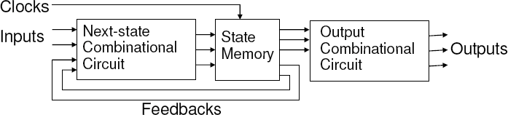
State Machine
Lecture 8 – 3
Generic Sequential Circuit is a Finite State Machine (FSM)
What is a state? A set of particular condition that the machine is in at a specific time
Represented by the content of the memory (registers) of the machine at a particular cycle
The state will only change at the clock edge, and will be kept during the clock period.
Since a sequential circuit has many memory and can have many states, so at a particular cycle, it can be in one of the finite set of states (determined by the number of memory element)
That is why we call it Finite State Machine (FSM)
The present state that the FSM is in depends on the history of inputs/time
The state-transitions are clearly defined (i.e. next states depends on present state and inputs)
State transitions occur at the active clock edge
State memory implemented by flip-flops
State transition (and output) logic implemented using combination logic

Slide 45

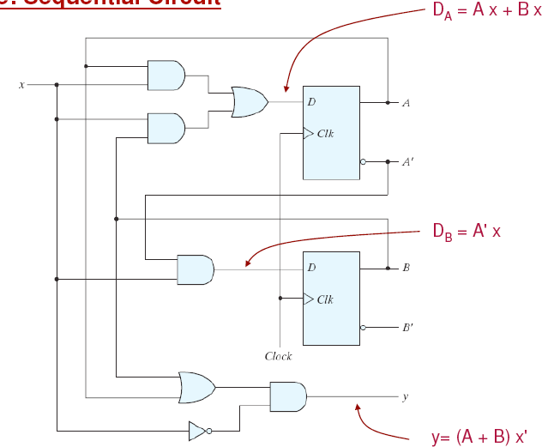
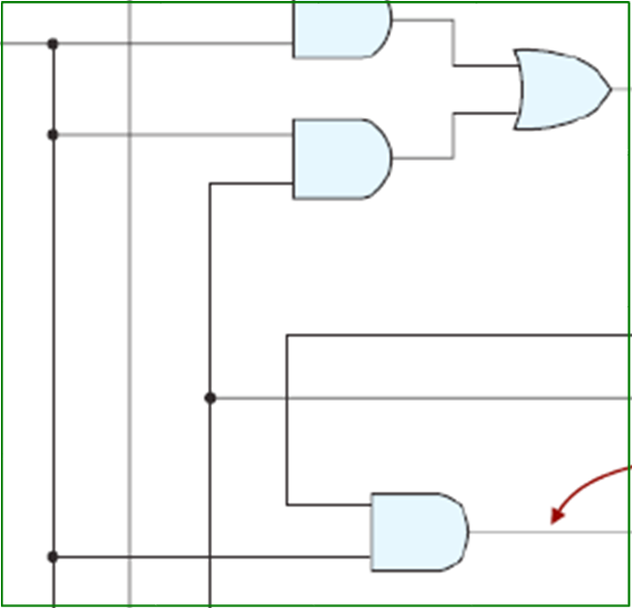
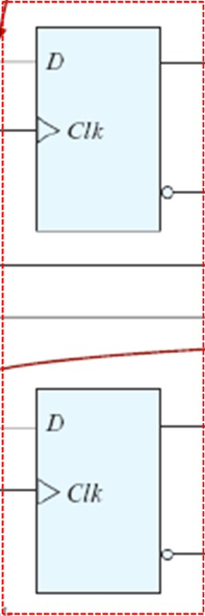
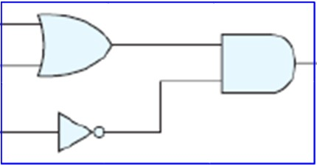
Example of Sequential Logic Circuit
Lecture 8 – 4
Next state logic
State register
(memory storing the state)
Output logic

Slide 46
State equations
Lecture 8 – 5
 Describe the behavior of a clocked sequential circuit algebraically.
 Possible states – values of all flip flops: (A,B in the previous example)
 D-input of a flip-flop
 Determine the values of the next state (i.e. the value of memory (or the state reached) after the next clock edge)
 Present state – state at time t,
 Next state – state at time t+1 (i.e. next clock cycle)
 State transition can be described by logic functions, e.g.
A(t + 1) = D_{A} (t) = A(t)x(t) + B(t)x(t)
B(t + 1) = D_{B} (t) = A'(t)x(t)
 Next state A(t+1)B(t+1) depends on present state A(t)B(t) and input x(t)
 Simpler form:
A⁺ = Ax + Bx B⁺ = A' x
or
A(t + 1) = Ax + Bx B(t + 1) = A' x

Slide 47
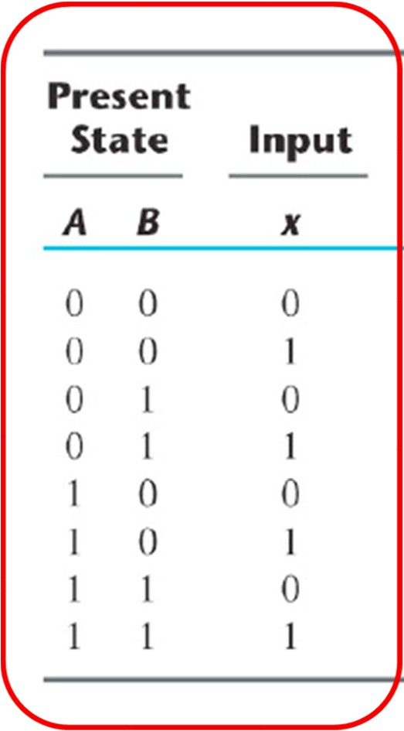

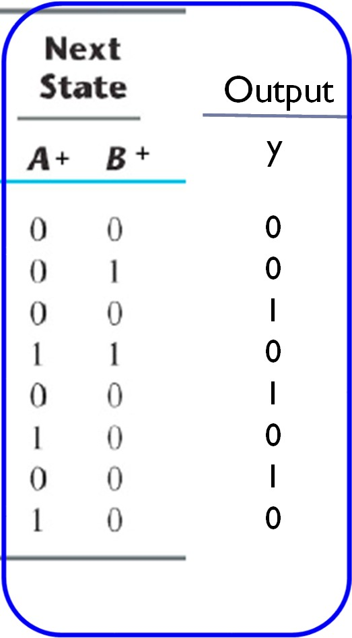
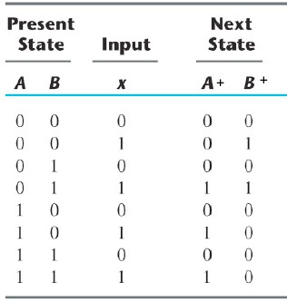
State Transition Table
Lecture 8 – 6
 Similar to a truth table
 list all possible values for the present state, and all possible inputs
 determine next state for each row
A⁺ = Ax + Bx B⁺ = A ' x
y = (A + B)x '
Like a truth table
Results
Output
y
0
0
1
0
1
0
1
0
0
1
2
3
4
5
6
7

Slide 48
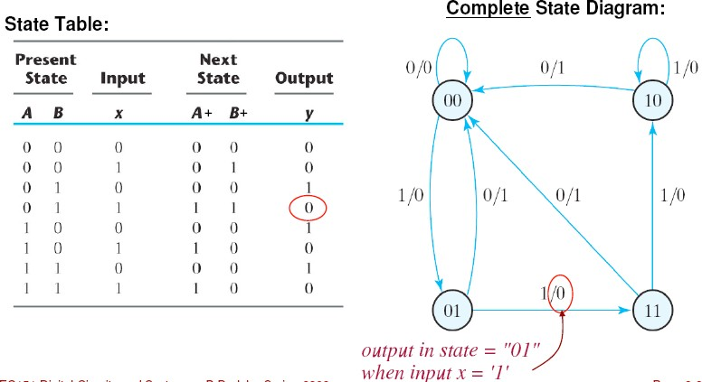
State Diagram (State transition diagram)
Lecture 8 – 7
 Graphical representation of the state table
 Circles – represent the States
 Edges – represent the state transition between states at the clock edge
 Values at an edge – (x/y) – x are the inputs to cause that transition and , y are the corresponding outputs for that transition
Output Logic Y = (A+B)x’
State value (A,B)
Input/output
for this transition
State transition When input x = 1 From (11) to (10)

Slide 49


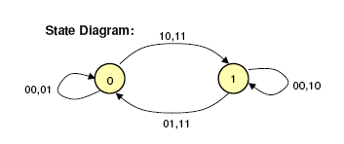
Example: J-K Flip Flop
Lecture 8 – 8
Q⁺ = JQ’ + K’Q
Next State
Behavior of the JK flip flop
Present State
The JK Flip Flop has two states

Slide 50
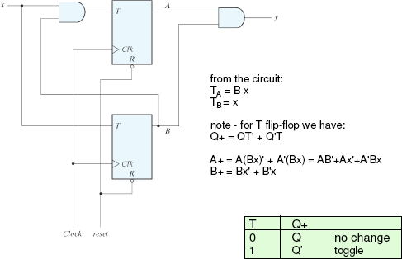
Another example: circuit using T Flip Flops
Lecture 8 – 9
A toggles whenever B is 1 given that x is 1
y is 1 only when A and B become 1
A B
0 0
0 1
1 0
1 1
B toggles as long as x is 1

Slide 51
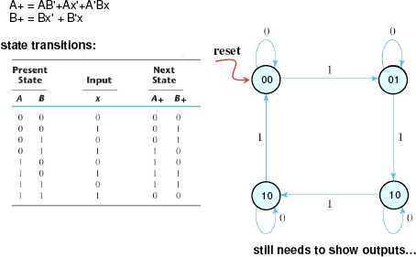
Another example: circuit using T Flip Flops
11

Slide 52
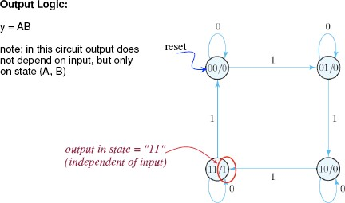
Another example: circuit using T Flip Flops
➔ Moore Machine: we put the output value inside the state bubbles because the output depends only the state value and it does not depend on the input!

Slide 53
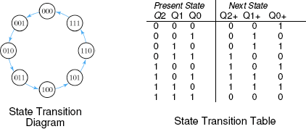
Example – 3-bit binary Up counter
Lecture 8 – 13
Start with state-transition diagram or table
Count sequence: 000, 001, 010, 011, 100, 101, 110, 111, 000, . . .
Number of states: 8, {000, 001, 010, 011, 100, 101, 110, 111}

Slide 54
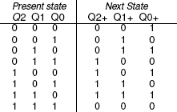


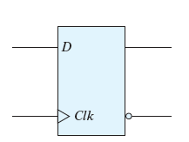
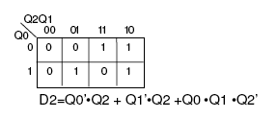


Example – 3-bit binary Up counter
Lecture 8 – 14
Design of next-state combinational logic
Inputs are present states
Outputs are inputs of D-type flip flops
Q_{N} =D_{N}
+
_{Q}+ _{Q}
Combinational logic design
1
LSB always toggles
D0 = Q0’
Toggles when Q0=1 D1 = Q1’
Otherwise D1=Q1 No change!
Toggles when Q0 and Q1 both are 1: D2 = Q2’
Otherwise D2 = Q2 No change!

Slide 55
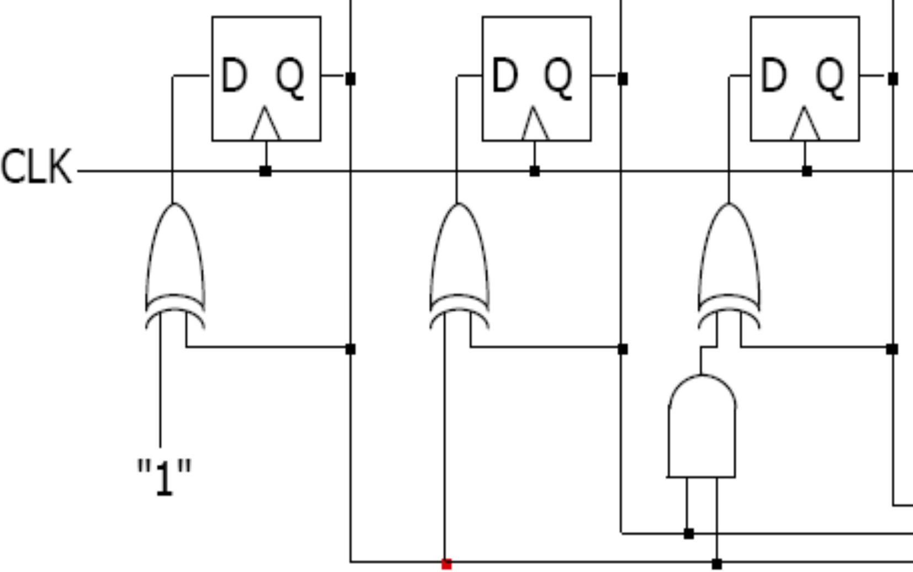
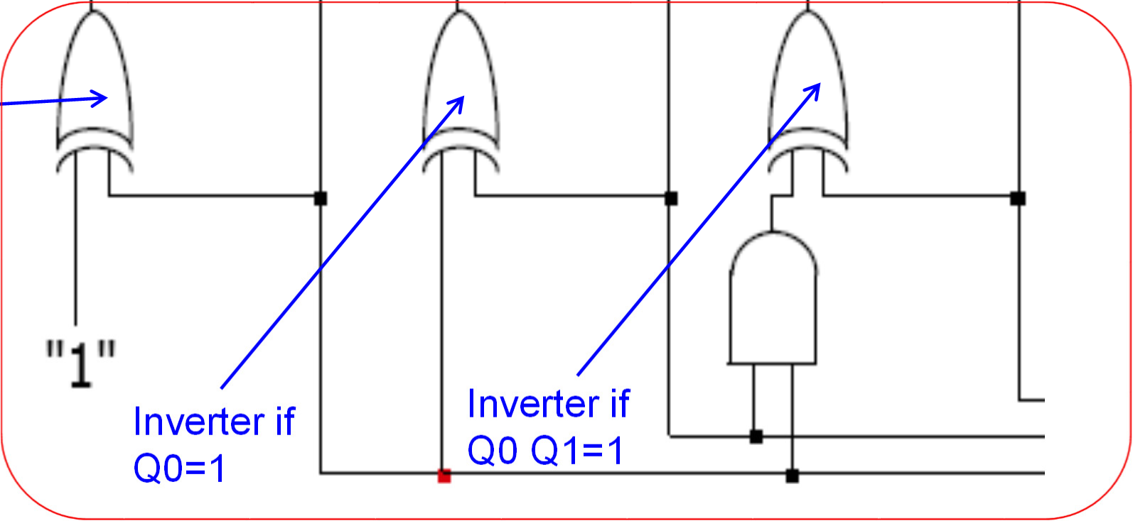
Example – 3-bit binary Up counter
Lecture 8 – 16
Implementation
Q0
_{Q1} Toggles if Q0 and Q1 _{Q2}
Toggles if Q0=1 D1 = Q1’
both are 1: D2 = Q2’
LSB always toggles
D0 = Q0’
Inverter
Next State Logic
_{Inverter if} Inverter if
_{Q0=1} Q0 Q1=1

Slide 56
Design with other types of Flip-Flops
Lecture 8 – 18
Design Procedure
Understand the problem
State-transition diagram and table
Selection of flip-flops
T, D or JK flip-flops
Design of next-state logic
Truth table
Inputs are current states
Outputs are inputs to the flip-flops
Derived from excitation table
Implementation

Slide 57

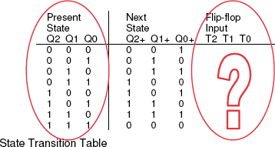

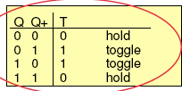


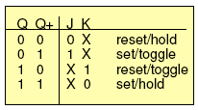
Example: 3-bit binary up counter with flip-flops
 Design of next-state combinational logic
 Inputs are present states
 Outputs are inputs of flip-flops
 How to derive the truth table of this next-state logic?
D Flip Flop
T Flip Flop
J-K Flip Flop

Slide 58
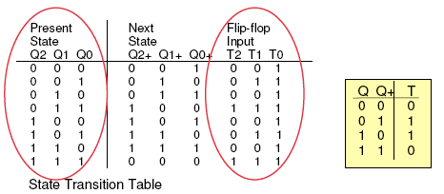



Example: 3-bit binary up counter with flip-flops
Lecture 8 – 20
K-maps of next-state logic T2
T1
T0
T2 = Q0.Q1
T1 = Q0
T0 = 1

Slide 59


Example: 3-bit binary up counter with flip-flops - Implementation
T1 = Q0
T2 = Q0.Q1
T0 = 1

Slide 60








Example: 3-bit binary up counter with flip-flops - Implementation
Both are T configuration

Slide 61


Another Counter Design Example
Lecture 8 – 23
 Understand the problem
 A more complex counter
 Count from 000, 001, 010, 100, 101, 110, and repeat
 State transition diagram and table
 Like truth table, there might be “don’t care” states
 Let’s use JK flip flop to implement this design
Reset
Skip 7
Skip 3
3 and 7 must be listed in the table even if the counter skips them (NS to be assigned Don’t cares!)

Slide 62




Another Counter Design Example
Lecture 8 – 24
Flip- Flop Excitation Tables
Design of next-state combinational logic
- Use excitation table of selected flip-flops to construct t
ruth table

Slide 63







Another Counter Design example – Next state logic
J2
J1
J0
J2=Q1 K2
J1=Q0 K1
J0=Q1’ K0
K2=Q1
K1=1
K0=1

Slide 64


Another Counter Design example – Next state logic - Implementation
J0=Q1’ J1=Q0
J2=Q1
K2=Q1
K0=1 K1=1
Q0
Q1
Q2
1
Q0’
1
Q1’
Q2’
CLK
 Using more complicated flip-flops sometimes simplifies next- state logic. In times when all logic was implemented using TTL devices and T and JK flipflops were available as 'single' devices, they were used to achieve reduced component count.
 But nowadays D-type flip-flop is usually the basic component (VLSI chip design, programmable logic design, etc.)

Slide 65


Another Counter Design example – Next state logic - Implementation
Last Step: Check for the unused states State 011 → Next State ???
1 →0
State 111 → Next State???
1 →0
1 →0
1 →0
0 →1
LSB
Q0
MSB
Q2
1 →0
Q1
1
Q0’
1
Q1’
Q2’
CLK
111
Skip 7
If the counter finds itself accidentally in the unused state 011, it will then go into the state 100 at the next clock cycle.
That is, it will self correct!
Reset
Same for the unused state 111; the counter will correct itself at the next clock cycle by moving into the valid state 000
011
Skip 3

Slide 66



Same Example but use T-FFs!
Lecture 8 – 29
Reset
Skip 7
Skip 3
3 and 7 must be listed in the table even if the counter skips them (NS to be assigned Don’t cares!

Slide 67
Same Example but use T-FFs!
ELEC2200 Fall 2014 – L.Yobas
Lecture 8 – 30
T Flip Flop
T2 0
0
1
X 0
0
1
X
T1 0
1
1
X 0
1
1
X
T0 1
1
0
X 1
1
0
X
Q2Q1
Q2Q1
Q2Q1
Q0
00 01 11 10
Q0
00 01 11 10
Q0
00 01 11 10
0 | 0 | 1 | 1 | 0 | 0 | 0 | 1 | 1 | 0 | 0 | 1 | 0 | 0 | 1
1 | 0 | X | X | 0 | 1 | 1 | X | X | 1 | 1 | 1 | X | X | 1
T2 = Q1
T1 = Q1+Q0
T0 = Q1’

Slide 68


Same Example but use T-FFs!
Lecture 8 – 32
T1 = Q1+Q0
T2 = Q1
T0 = Q1’
Q0
Q1
Q2
Q0’
Q1’
Q2’
CLK

Slide 69
Same Example but use T-FFs!
Lecture 8 – 33
Last Step: Check for the unused states
State 111 → Next State???
1 →0
1 →0
State 011 → Next State ???
1 →1
1 →1
1 →0
0 →1
Q0
LSB
Q1
Q2
MSB
Q0’
Q1’
Q2’
CLK
111
Skip 7
If the counter finds itself accidentally in the unused state 011, it will then go into the state 101 at the next clock cycle.
That is, it will self correct!
Reset
Same for the unused state 111; the counter will correct itself at the next clock cycle by moving into the valid state 001
011
Skip 3

Slide 70
Same Example: Compare
Lecture 8 – 34
Q0
Q1
Q2
1
Q0’
1
Q1’
Q2’
Q⁺ = JQ’ + K’Q
When K = 1, Q+ = JQ’
CLK
Are both the same? Why?
Q⁺ = TQ’ + T’Q
Q0
Q1
Q2
Q0’
Q1’
Q2’
CLK

Slide 71




Same Example: Worst Case Scenario
Lecture 8 – 35
Why do we need to check for the unused states???
Because the FSM may cycle from one unused state to another and if it does, it will never recover (correct) itself unless you reset it!
If this condition is likely to occur, you will have to force some or all of the “don’t cares” to either 0 or 1 (valid state)
Reset
111
011

Slide 72
State Reduction
Lecture 9 – 30
 Two FSM are equivalent if they produce the same output sequences given the same input sequences.
 The internal 'states' are not relevant from the observer point of view
 Hence, for a given state machine we can try to find an equivalent state machine, with fewer internal states (i.e. simpler? fewer flip-flops? perhaps…)
 The principle of FSM state reduction is based on identifying and merging equivalent states.
 "Two internal states are said to be equivalent if for each input combination they give exactly the same output and send the circuit to either the same state or to an equivalent state"

Slide 73

State Reduction (Section 5-6)
Lecture 9 – 31
 Given a state-transition diagram
 Find and combine equivalent states
 Equivalent states have the same output and transition
 Textbook example
 7 states
 1 input
 Table is more readable

Slide 74
State Reduction, Textbook Example
Lecture 9 – 32
 Row matching method
 e and g are equivalent states
 Remove state g and send FSM to state e instead of g wherever required!
Present Next State State x = 0 x = 1
a a b
Output
x = 0 x = 1
0 0
Two internal states are said to be equivalent if for each input combination they give exactly the same output and send the circuit to either the same state or to an equivalent state"
b | c | d | 0 | 0
c | a | d | 0 | 0
d | e | f | 0 | 1
e | a | f | 0 | 1
f | g | f | 0 | 1
g | a | f | 0 | 1
Present State
Next State x = 0 x = 1
Output
x = 0 x = 1
a | a | b | 0 | 0
b | c | d | 0 | 0
c | a | d | 0 | 0
d | e | f | 0 | 1
e | a | f | 0 | 1
f | e | f | 0 | 1

Slide 75
State Reduction, Textbook Example
Lecture 9 – 33
 Row matching method
 d and f are equivalent states
 Remove state f and send FSM to state d instead of f wherever required!
Present Next State State x = 0 x = 1
Output
x = 0 x = 1
a | a | b | 0 | 0
b | c | d | 0 | 0
c | a | d | 0 | 0
d | e | f | 0 | 1
e | a | f | 0 | 1
f | e | f | 0 | 1
Present State
Next State x = 0 x = 1
Output
x = 0 x = 1
a | a | b | 0 | 0
b | c | d | 0 | 0
c | a | d | 0 | 0
d | e | d | 0 | 1
e | a | d | 0 | 1

Slide 76
State Reduction, Textbook Example
Lecture 9 – 34
 c and e have the same state transition with respect to the input, but have different output behavior
 Next, check whether d and e are equivalent
 Both produced the same outputs for given inputs
 They both send the FSM to the same state (d) but differ in other states (a and e)
 To ensure you need to check whether the states a and e are equivalent!
 The states a and e are not equivalent because they differ in the output values
 Also you need to check whether the states a, b, and c are equivalent
 The states a and c are equivalent if b and d are equivalent. However, the states b and d are NOT equivalent because they differ in output
Present Next State State x = 0 x = 1
Output
x = 0 x = 1
a | a | b | 0 | 0
b | c | d | 0 | 0
c | a | d | 0 | 0
d | e | d | 0 | 1
e | a | d | 0 | 1

Slide 77

State Reduction, Textbook Example, Continued
Lecture 9 – 35
 c and e have the same state transition with respect to the input, but have different output behavior
 Reduced the number of states from 7 to 5
 Input-output relation is preserved with 5 states.
 Just by looking at the input and output relation, the user cannot tell the difference between the FSM with 7 states and the FSM with 5 states!
Present Next State State x = 0 x = 1
Output
x = 0 x = 1
a | a | b | 0 | 0
b | c | d | 0 | 0
c | a | d | 0 | 0
d | e | d | 0 | 1
e | a | d | 0 | 1
NB. For more complex state machines, various methods and algorithms are used to find and merge equivalent states…

Slide 78
Optimization Steps
Lecture 9 – 36
 State reduction
 Given a state-transition diagram
 Find and combine equivalent states
 The goal is to reduce the number of states
 searching the state space and merging equivalent states…
 State assignment
 Given a symbolic state-transition table
 Assign binary values to the states and obtain an encoded state transition table
 The goal is to find a table that can lead to fewer gate count in the next-state and output logic!
 implementation space is very large - many possible state assignments, each results in different minimised logic…

Slide 79

Finite State Machine (FSM)
Lecture 8 – 36
 FSM is a generic synchronous sequential circuit
 FSM has state memory, inputs and outputs
 State memory is implemented by flip-flops
 State-transition logic implemented using combinational logic
 Output logic implemented using combinational circuit
 Output depends on state only – Moore machine
 Output depends on state and input – Mealy machine

Slide 80

Moore machine vs. Mealy machine
Lecture 9 – 9
Moore Machine
Outputs are function solely of the current states
Outputs change synchronously with states
Mealy Machine
Outputs depend on state AND inputs
Change of inputs causes an immediate change of outputs

Slide 81

Moore machine vs. Mealy machine
Lecture 9 – 10
Dashed lines indicate hypothetical points when the clock edges are received
In MEALY, output changes without the clock edge (temporarily false value!)

Slide 82
Basic Design Steps of FSM
Lecture 9 – 4
 1. Understand the Specifications
 With a block diagram
 2. Obtain an abstract specification of the FSM
 In state-transition diagram or table
 3. Perform state reduction
 Equivalent states can be merged
 4. Perform state assignment
 Assign binary values to the states in a way that next-state logic can be simplified
 5. Choose FF to implement the FSM state register
 T, D and JK flip-flops
 6. Implement the FSM
 Design of next-state and output logic
 A best design has fewer overall gate counts
 (7.Testing)

Slide 83


Another Example - Sequence Detector
Lecture 9 – 37
 A sequence detector has an input (x) and an output (y)
 The output is asserted when the desired input sequence is detected
 e.g. detect 3 or more consecutive 1’s
 Sample input/output behavior
 X: 01001100011100001 0000011111
 Y: 000000000001000000110000000111
 Moore or Mealy machine
 Let’s try Moore first
 Other kinds of sequence detector
 more than one sequence
 packet sequence; n bits in a group
111
 X:
 Y:
010 011 000 111 000 011 110 000 011 111
000 000 000 001 000 000 000 000 000 001

Slide 84



State Diagram of the Sequence Detector
Lecture 9 – 38
 1. Obtain the state-transition diagram
 Step by step and re-use the state
Reset Reset
Reset
Reset
0
S0 [0]
0
S0 [0]
0
S0 [0]
0
S0 [0]
1
1
1
1
S1 [0]
0
S1 [0]
0
S1 [0]
0
S1 [0]
0
0
1
1
1
S2 [0]
S2 [0]
0
S2 [0]
1
1
S3 [1]
S3 [1]
1

Slide 85



Minimized State Diagram of the Sequence Detector
 2. Perform state reduction
 State reduction was performed in step 2 when states were re-used
Reset
S0
0
[0]
1
0
S1 [0]
0
1
0
S2 [0]
1
S3 [1]
1

Slide 86

State Assignment of the Sequence Detector
Lecture 9 – 40
 3. Perform state assignment
 S0 is the initial state (0 0)
 Binary assignment of the rest; or gray-code assignment
Reset
Present Next State
State x = 0 x = 1
Output
x = 0 x = 1
0
S0
 | [0] | S0 | S0 | S1 | 0 | 0
1 |  | S1 | S0 | S2 | 0 | 0
 |  | S2 | S0 | S3 | 0 | 0
 | S1 ₀ | S3 | S0 | S3 | 1 | 1
0
[0]
Symbolic State Transition Table
1
Present Next State
State x = 0 x = 1 A+ B+
Output
x = 0 x = 1
0
S2 [0]
A B A+ B+
0 | 0 | 0 | 0 | 0 | 1 | 0 | 0
0 | 1 | 0 | 0 | 1 | 0 | 0 | 0
1 | 0 | 0 | 0 | 1 | 1 | 0 | 0
1 | 1 | 0 | 0 | 1 | 1 | 1 | 1
1
S3 [1]
1
Encoded State Transition Table

Slide 87

Implementation of the Sequence Detector
Lecture 9 – 41
 4. Choose FF to implement: how about with DFF?
 Note the ABx placement
 8 literals and 6 equivalent gates for the next-state logic
 How many equivalent gate for the output logic
1.5 equivalent gates by NAND-NOT
1 equivalent gate by NOT-NOR

Slide 88

Implementation of the Sequence Detector with DFF
Lecture 9 – 42
A⁺ = Ax + Bx
B⁺ = Ax + B’x
y = AB

Slide 89
Selection of Flip-flop for the Sequence Detector
Lecture 9 – 43
 4. Choose FF to implement: how about with JK?
 Try to implement with JK flip-flops
 Derive truth table for next-state and output logic
Present State
A B 0 0
Next
Input State Output x A+ B+ y
0 0
JA KA
JB KB
TA TB
0 0
0 1
0 0
1 0
0 0
1 1
0 0
1 1
0 x
0 x
x
x
x 1
x 0
x 1
x 0
0 x 0 0
1 x 0 1
x 1 0 1
x 1 1 1
0 x 1 0
1 x 0 1
x 1 1 1
x 0 0 0
0 0
0 1
0 1
1 0
1 0
1 1
1 1
1
0
1
0
1
0
1
0
0
0
0
0
1
1

Slide 90
Implementation of the Sequence Detector with JKFF
AB |  |  |  |  |  | AB
0 | 00 0 | 01 0 | 11 X | 10 X | x | 0 | 00 X | 01 X | 11 1 | 10 1
1 | 0 | 1 | X | X |  | 1 | X | X | 0 | 0
x
AB
 | 00 | 01 | 11 | 10
0 | 0 | 0 | 1 | 0
1 | 0 | 0 | 1 | 0
J_{A} = Bx
K_{A} = x’
x
AB
AB
x |  | 00 | 01 | 11 | 10 | x |  | 00 | 01 | 11 | 10
 | 0 | 0 | X | X | 0 |  | 0 | X | 1 | 1 | X
 | 1 | 1 | X | X | 1 |  | 1 | X | 1 | 0 | X
y = AB
J_{B} = x
K_{B}= x’+A’

Slide 91

Implementation of the Sequence Detector with JKFF
J_{A} = Bx
y = AB
x
A
K_{A} = x’
A’
J_{B} = x
B
B’
K_{B}= x’+A’

Slide 92
Implementation of the Sequence Detector with JKFF
AB AB
x
00 01 11 10 _{x} 00 01 11 10
0 | 0 | 0 | 1 | 1 | 0 | 0 | 1 | 1 | 0
1 | 0 | 1 | 0 | 0 | 1 | 1 | 1 | 0 | 1
T_{A} = Ax’+A’Bx
T_{B} = Bx’+A’x+B’x
Present State |  | Input | Next State |  | Output
A B |  | x | A+ B+ |  | y | JA KA |  | JB KB |  | TA TB
0 | 0 | 0 | 0 | 0 | 0 | 0 | x | 0 | x | 0 | 0
0 | 0 | 1 | 0 | 1 | 0 | 0 | x | 1 | x | 0 | 1
0 | 1 | 0 | 0 | 0 | 0 | 0 | x | x | 1 | 0 | 1
0 | 1 | 1 | 1 | 0 | 0 | 1 | x | x | 1 | 1 | 1
1 | 0 | 0 | 0 | 0 | 0 | x | 1 | 0 | x | 1 | 0
1 | 0 | 1 | 1 | 1 | 0 | x | 0 | 1 | x | 0 | 1
1 | 1 | 0 | 0 | 0 | 1 | x | 1 | x | 1 | 1 | 1
1 | 1 | 1 | 1 | 1 | 1 | x | 0 | x | 0 | 0 | 0

Slide 93


Implementation of the Sequence Detector with TFF
T_{A} = Ax’+A’Bx
x
y = AB
A
A’
T_{B} = Bx’+A’x+B’x
B
B’

